Slide 1

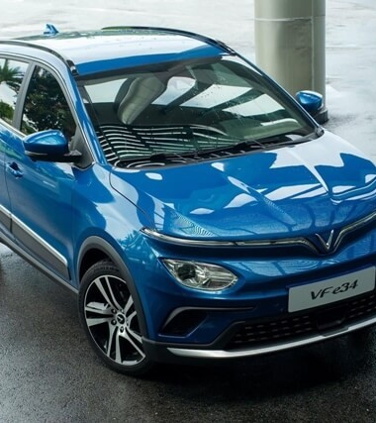
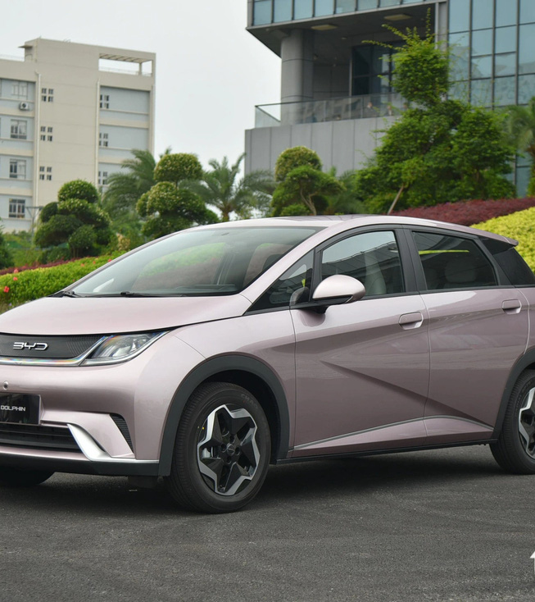
VFe34 VS BYD DOLPHIN PQ EVALUATION REPORT
August 27th 2024

Slide 2
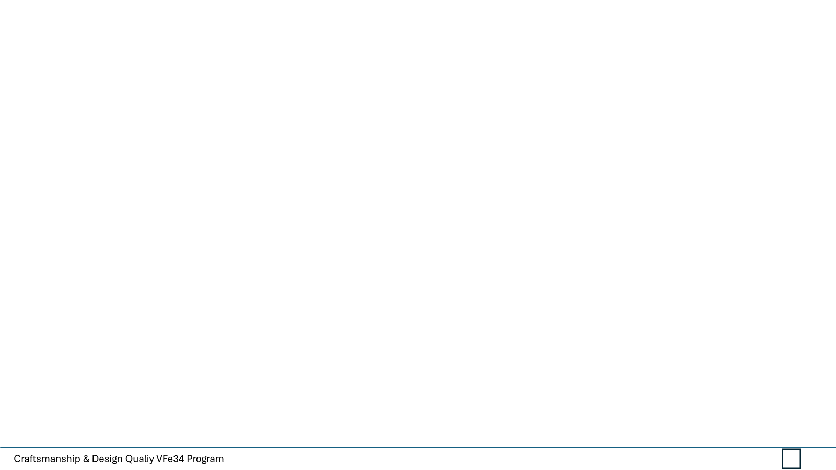
VFe34 VS BYD DOLPHIN PQ EVALUTATION REPORT
Objective :
To compare the VFe34 product to BYD Dolphin, highlighting areas for improvement and design/features/executions to be investigated
2. Evaluation Criteria :
CRITERIA | EVALUATION DESCRIPTION | SCORE
INNOVATIVE | Does the product have innovative design that improves upon the previous version? | 1-10
FUNCTIONALITY | Intuitively understand of the functions and emphasizes the usefulness and easy of use. | 1-10
AESTHETIC | Visually appealing. Including fit & finish. Surface quality ( grain, stitching) interior/ exterior harmony of color & lighting | 1-10
CLARITY( SIMPLE) | Self explanatory use of functions with consideration of ergonomics and environments of space. | 1-10
AUTHENTIC (HONEST) | No fake design. It does not attempt to manipulate the customer. | 1-10
MATERIALS | Material choice should be considering user case and quality expectation of the product. | 1-10
SOUND QUALITY | The sounds associated with the vehicle, including the noise level inside the cabin, the sound of the operation of doors and other movable parts. | 1-10
TOUCH & FEEL | The feel of materials and surfaces when touched, such as the softness of the leather, the solidity of controls, and the quality of trim and fittings. | 1-10

Slide 3
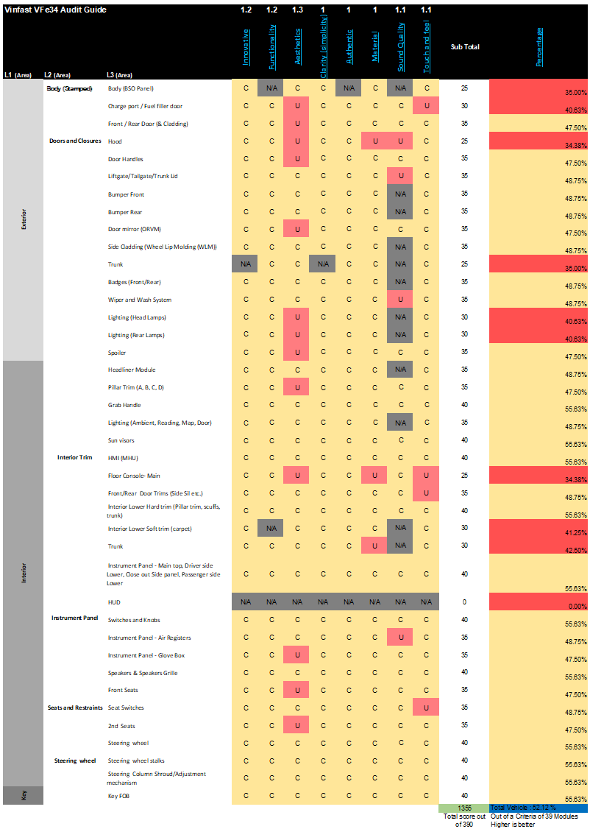
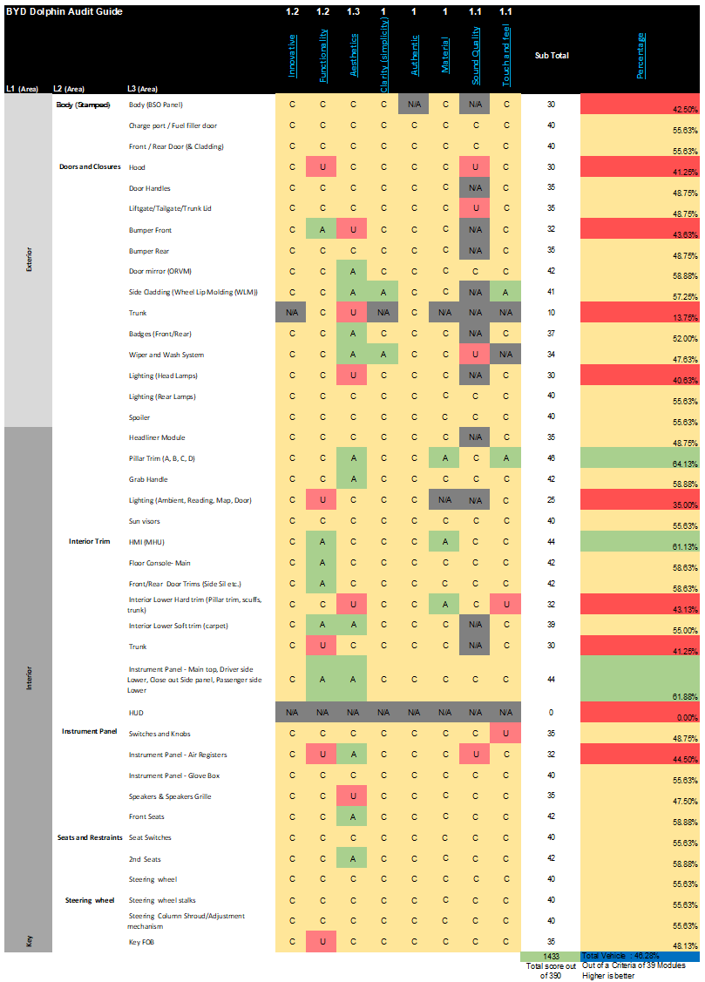
VFe34 VS BYD DOLPHIN PQ EVALUTATION REPORT
VFe34 Detail report
BYD Dolphin Detail report

Slide 4
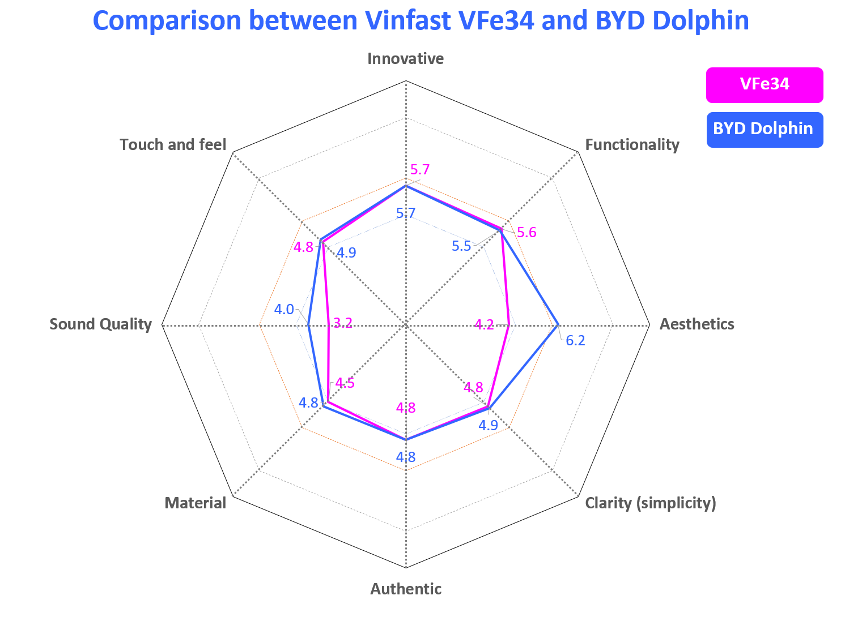
VFe34 VS BYD DOLPHIN PQ EVALUTATION REPORT
Summary of PQ audit
Compare with BYD Dolphin, we realize that VFe34 is not competitive than BYD Dolphin
Recommendation
Short term improve
Gap & Flush improvement in Exterior and Interior
Long term improve
Adopt better GD&T systems/practices from Design, manufacture and assembly.
PQ team involvement early in the program with strong voice championing quality.
Improve Fit and Finish by investigating and eliminating root causes from error states.
Give more control over PHC and JIRA decisions that impact PQ outcomes.
Border definition:
Uncompetitive - Competitive = 4.5
Competitive - Amongst Leaders = 6
Amongst Leaders - Leadership = 8
Over Leadership = 10

Slide 5
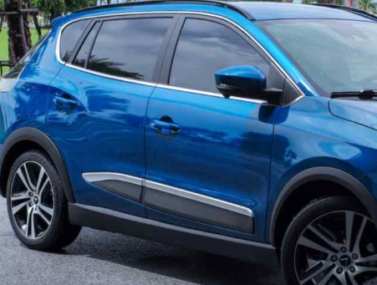
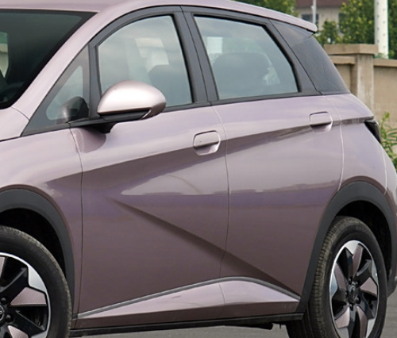
VFe34 VS BYD DOLPHIN PQ EVALUTATION REPORT
Comparison: Front/Rear Doors & Handles
VFe34 |  | BYD Dolphin
Innovative design | C | Innovative design | C
Functionality | C | Functionality | C
Aesthetic | U | Aesthetic | C
Clarity & Simplicity | C | Clarity & Simplicity | C
Authentic | C | Authentic | C
Material | C | Material | C
Sound Quality | C | Sound Quality | C
Touch and Feel | C | Touch and Feel | C
Total Score | 47.50% | Total Score | 55.63%
Old Fashioned Door handles fees not competitive |  | Flush Handles feels the better appearance in the customer point of view.

Slide 6
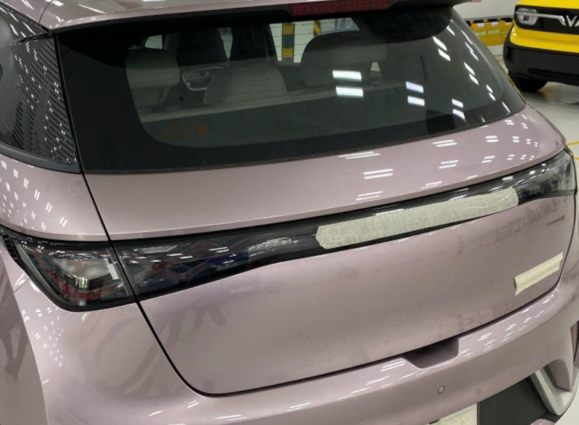
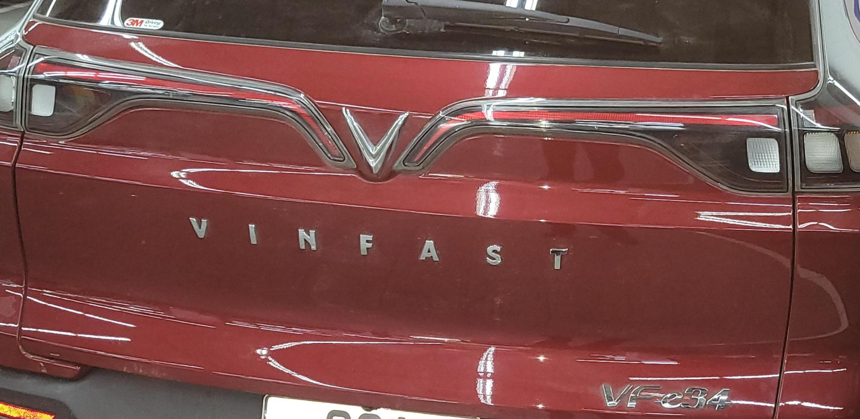
VFe34 VS BYD DOLPHIN PQ EVALUTATION REPORT
Comparison: Rear Lamps
VFe34 |  | BYD Dolphin
Innovative design | C | Innovative design | C
Functionality | C | Functionality | C
Aesthetic | U | Aesthetic | A
Clarity & Simplicity | C | Clarity & Simplicity | C
Authentic | C | Authentic | C
Material | C | Material | C
Sound Quality | C | Sound Quality | C
Touch and Feel | C | Touch and Feel | C
Total Score | 47.50% | Total Score | 55.63%
Bulb type Lamp Design is un-Competitive |  | Best Illuminated LED type.

Slide 7
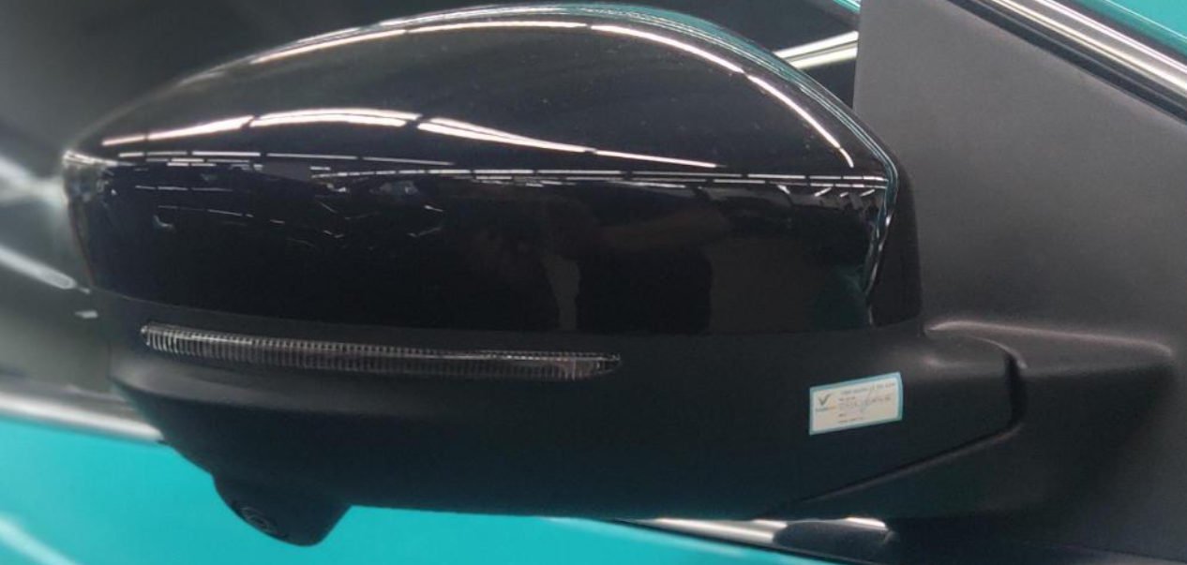
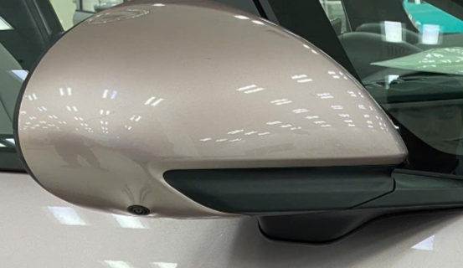
VFe34 VS BYD DOLPHIN PQ EVALUTATION REPORT
Comparison: Door Mirror
VFe34 |  | BYD Dolphin
Innovative design | C | Innovative design | C
Functionality | C | Functionality | C
Aesthetic | U | Aesthetic | A
Clarity & Simplicity | C | Clarity & Simplicity | C
Authentic | C | Authentic | C
Material | C | Material | C
Sound Quality | C | Sound Quality | C
Touch and Feel | C | Touch and Feel | C
Total Score | 47.50% | Total Score | 58.88%
Big Shaped Mirror and Camera protrusion is very high |  | Very sleek and compact design Camera is Optimal protrusion

Slide 8
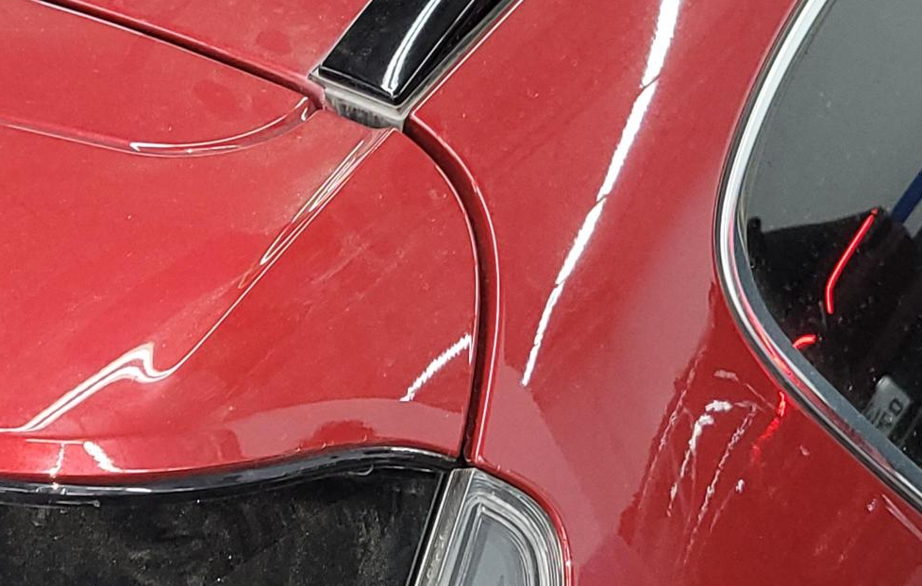
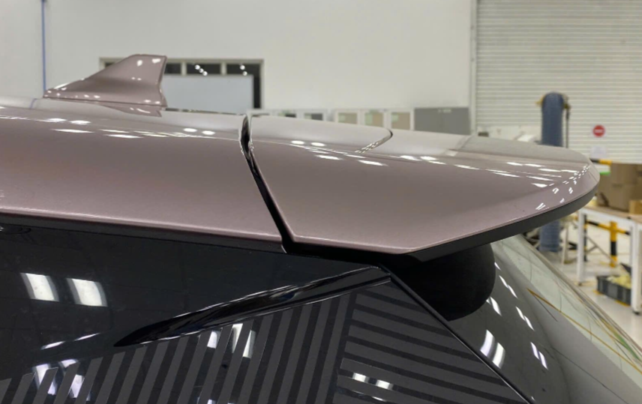
VFe34 VS BYD DOLPHIN PQ EVALUTATION REPORT
Comparison: Spoiler
VFe34 |  | BYD Dolphin
Innovative design | C | Innovative design | C
Functionality | C | Functionality | C
Aesthetic | U | Aesthetic | C
Clarity & Simplicity | C | Clarity & Simplicity | C
Authentic | C | Authentic | C
Material | C | Material | C
Sound Quality | C | Sound Quality | C
Touch and Feel | C | Touch and Feel | C
Total Score | 47.50% | Total Score | 55.63%
Poor gap parallel quality with Old design. |  | Best fit and finish achieved.

Slide 9

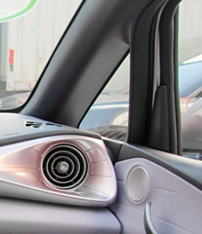
VFe34 VS BYD DOLPHIN PQ EVALUTATION REPORT
Comparison: Pillar trim
VFe34 |  | BYD Dolphin
Innovative design | C | Innovative design | C
Functionality | C | Functionality | C
Aesthetic | U | Aesthetic | A
Clarity & Simplicity | C | Clarity & Simplicity | C
Authentic | C | Authentic | C
Material | C | Material | A
Sound Quality | C | Sound Quality | C
Touch and Feel | C | Touch and Feel | A
Total Score | 47.50% | Total Score | 64.13%
Poor Material Quality creates less appearance. |  | Well executed modern design, with good Touch and feel and materials.

Slide 10
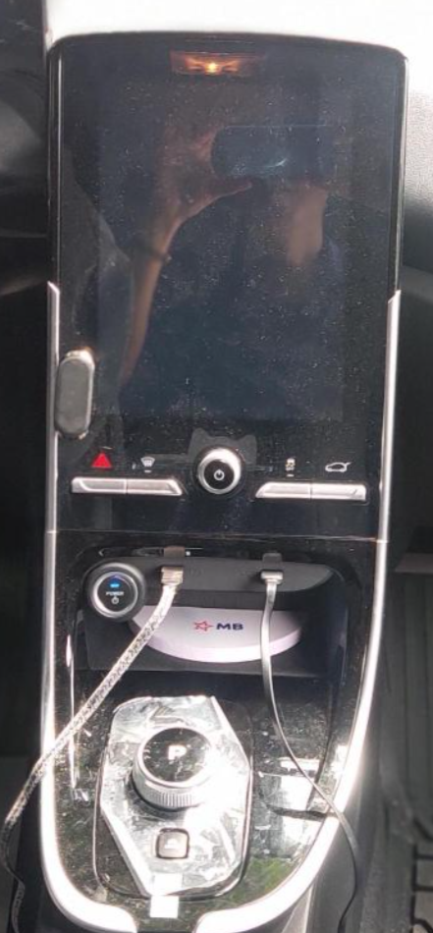
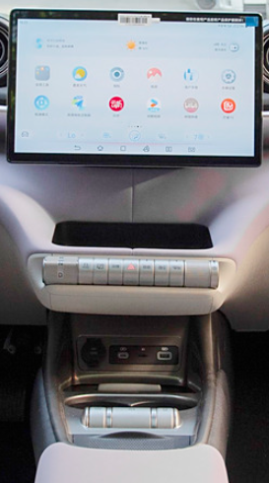
VFe34 VS BYD DOLPHIN PQ EVALUTATION REPORT
Comparison: HMI (MHU)
VFe34 |  | BYD Dolphin
Innovative design | C | Innovative design | C
Functionality | C | Functionality | A
Aesthetic | C | Aesthetic | C
Clarity & Simplicity | C | Clarity & Simplicity | C
Authentic | C | Authentic | C
Material | C | Material | A
Sound Quality | C | Sound Quality | C
Touch and Feel | C | Touch and Feel | C
Total Score | 55.63% | Total Score | 61.13%
Normal Fixed Type MHU comparatively smaller in size. |  | Can be functionally able to rotate the Screen and bigger in Size.

Slide 11
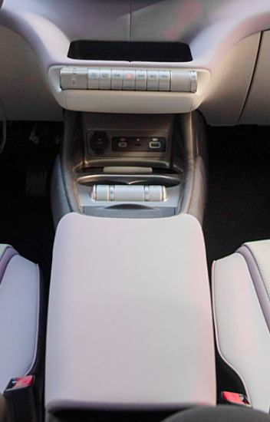
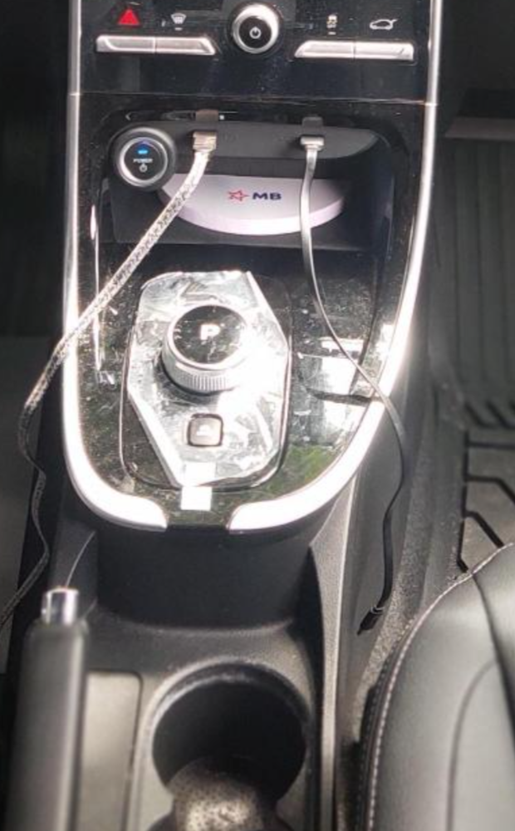
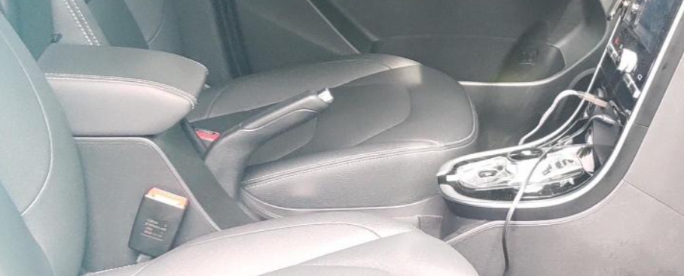
VFe34 VS BYD DOLPHIN PQ EVALUTATION REPORT
Comparison: Floor Console
VFe34 |  | BYD Dolphin
Innovative design | C | Innovative design | C
Functionality | C | Functionality | A
Aesthetic | U | Aesthetic | C
Clarity & Simplicity | C | Clarity & Simplicity | C
Authentic | C | Authentic | C
Material | U | Material | C
Sound Quality | C | Sound Quality | C
Touch and Feel | U | Touch and Feel | C
Total Score | 34.38% | Total Score | 58.63%
Look like cheap material, feel not premium and not luxury. |  | Longer Arm Rest Provision is good.

Slide 12
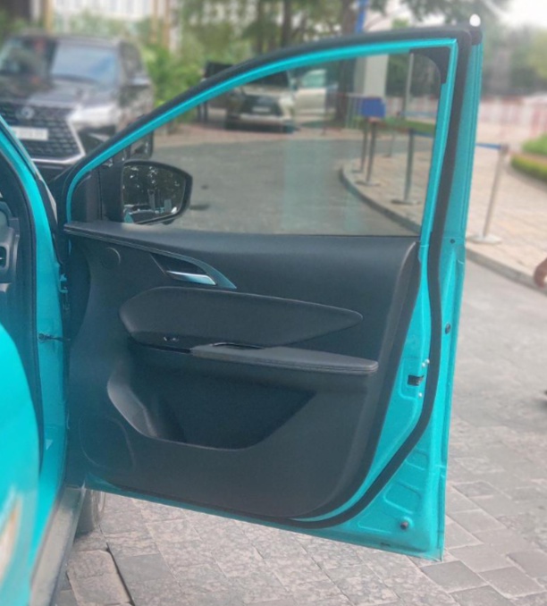
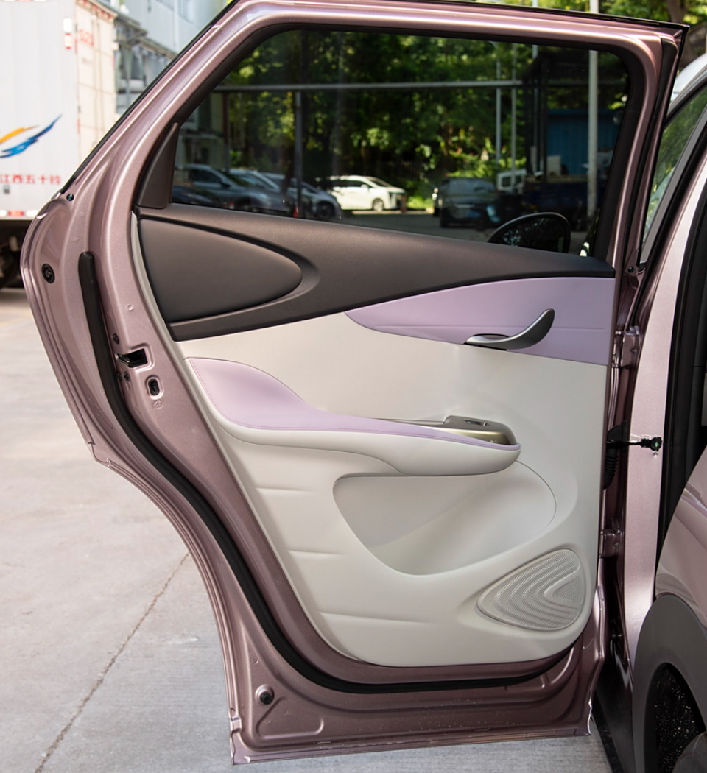
VFe34 VS BYD DOLPHIN PQ EVALUTATION REPORT
Comparison: Front/Rear Door trim
VFe34 |  | BYD Dolphin
Innovative design | C | Innovative design | C
Functionality | C | Functionality | A
Aesthetic | C | Aesthetic | C
Clarity & Simplicity | C | Clarity & Simplicity | C
Authentic | C | Authentic | C
Material | C | Material | C
Sound Quality | C | Sound Quality | C
Touch and Feel | U | Touch and Feel | C
Total Score | 48.75% | Total Score | 58.63%
Simply design, not feel premium for user. |  | Door opening handle is ergonomically in a good position.

Slide 13
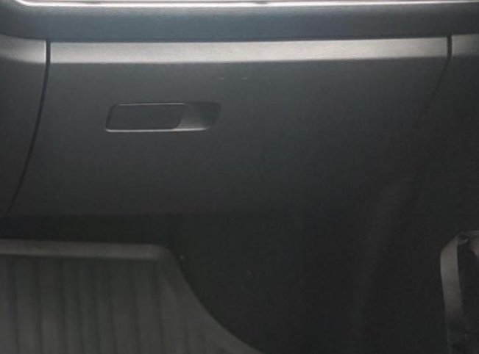
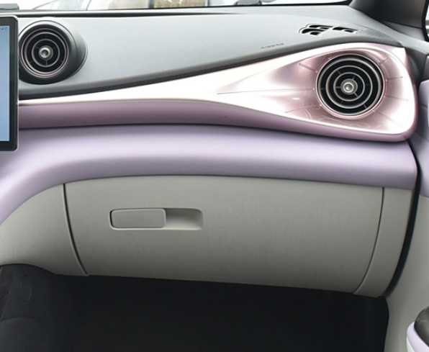
VFe34 VS BYD DOLPHIN PQ EVALUTATION REPORT
Comparison: IP& Glove Box.
VFe34 |  | BYD Dolphin
Innovative design | C | Innovative design | C
Functionality | C | Functionality | C
Aesthetic | U | Aesthetic | C
Clarity & Simplicity | C | Clarity & Simplicity | C
Authentic | C | Authentic | C
Material | C | Material | C
Sound Quality | C | Sound Quality | C
Touch and Feel | C | Touch and Feel | C
Total Score | 47.50% | Total Score | 55.63%
Old and Simple Design ( Outdated design). Not competitive |  | Well executed combining Glove box and IP make design beautiful

Slide 14
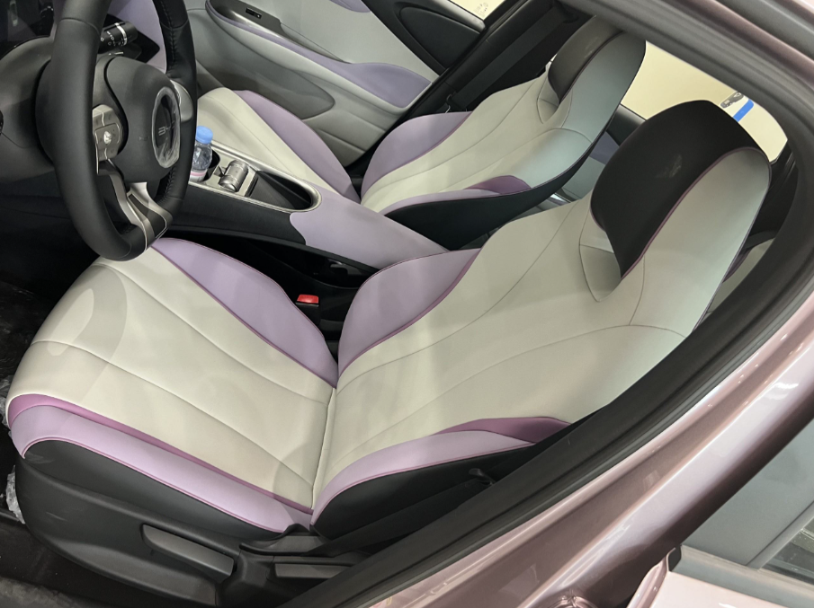
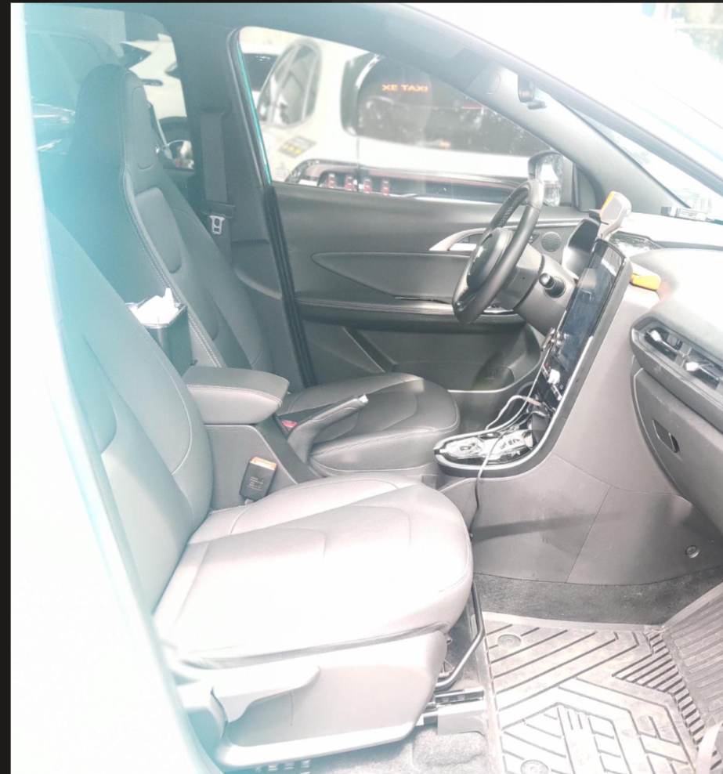
VFe34 VS BYD DOLPHIN PQ EVALUTATION REPORT
Comparison: Front Seats
VFe34 |  | BYD Dolphin
Innovative design | C | Innovative design | C
Functionality | C | Functionality | C
Aesthetic | U | Aesthetic | A
Clarity & Simplicity | C | Clarity & Simplicity | C
Authentic | C | Authentic | C
Material | C | Material | C
Sound Quality | C | Sound Quality | C
Touch and Feel | C | Touch and Feel | C
Total Score | 47.50% | Total Score | 58.88%
Single Color and simple design. |  | Well executed design with Dual Tone Colors on Seats matching with Body Color.

Slide 15
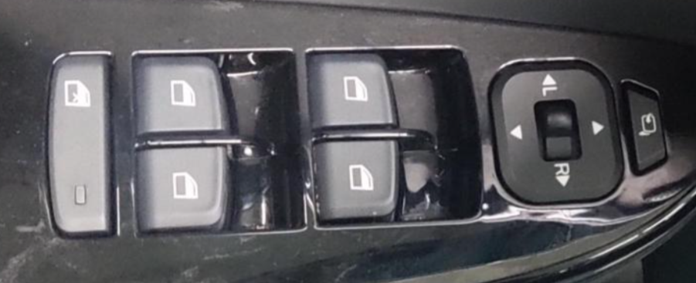
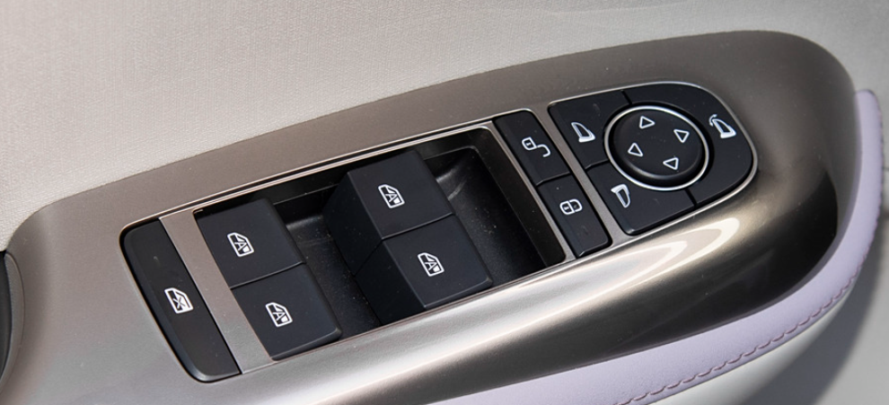
VFe34 VS BYD DOLPHIN PQ EVALUTATION REPORT
Comparison: Seat switches
VFe34 |  | BYD Dolphin
Innovative design | C | Innovative design | C
Functionality | C | Functionality | C
Aesthetic | C | Aesthetic | C
Clarity & Simplicity | C | Clarity & Simplicity | C
Authentic | C | Authentic | C
Material | C | Material | C
Sound Quality | C | Sound Quality | C
Touch and Feel | U | Touch and Feel | C
Total Score | 47.50% | Total Score | 55.63%
Cheap appearance surface finish. Not competitive |  | Well executed/robust design with high texture finish

Slide 16
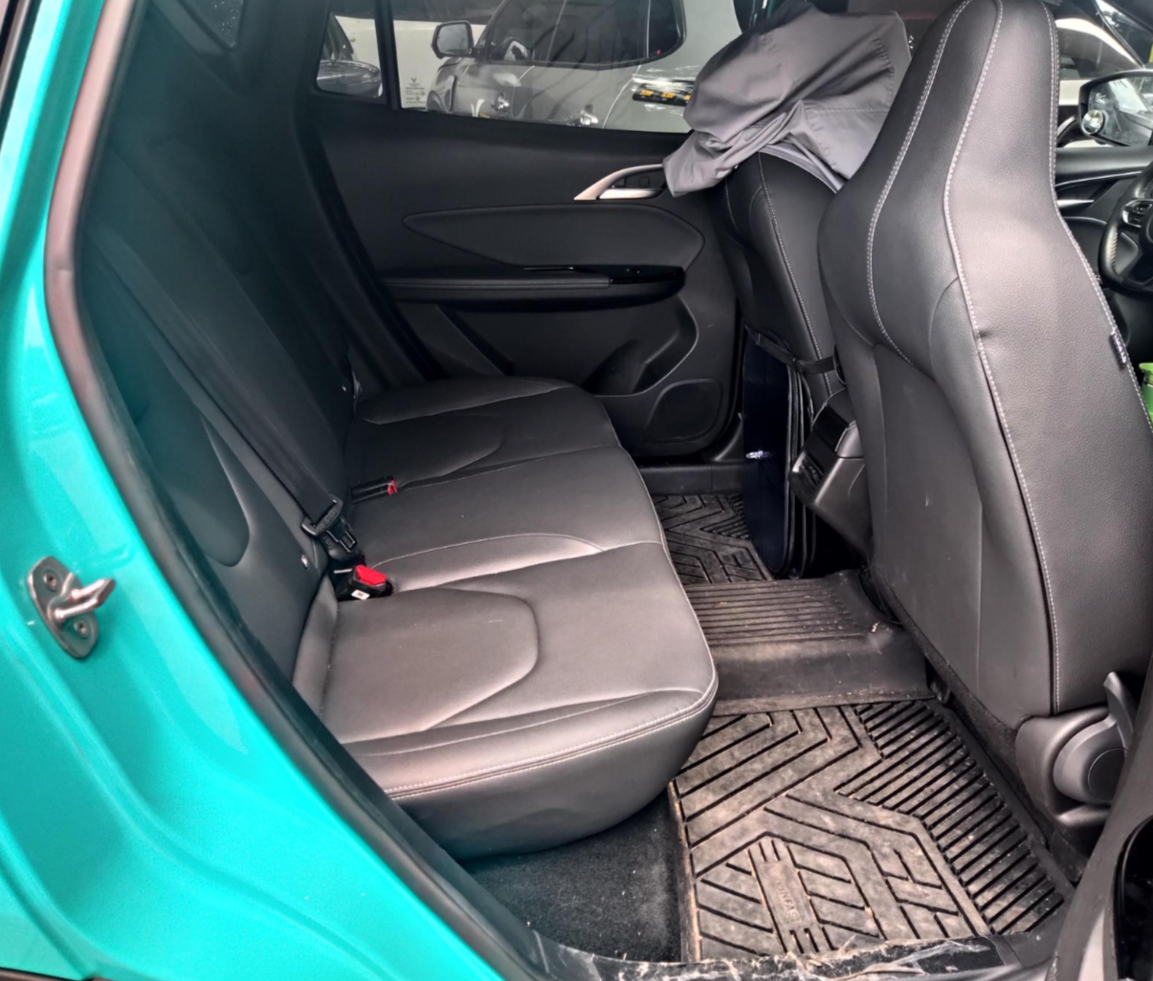
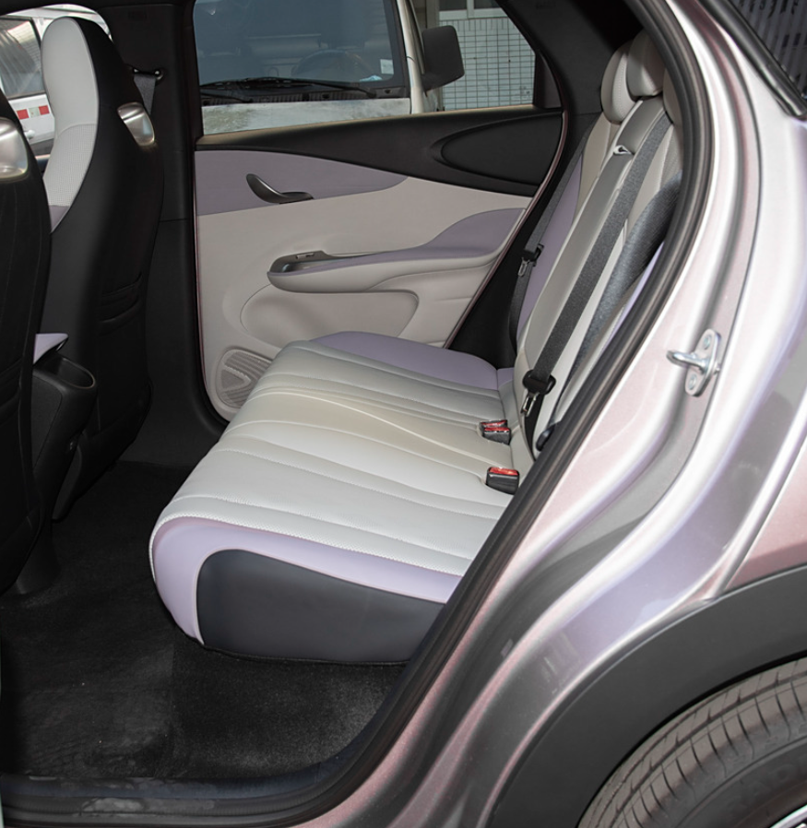
VFe34 VS BYD DOLPHIN PQ EVALUTATION REPORT
Comparison: 2nd Seats
VFe34 |  | BYD Dolphin
Innovative design | C | Innovative design | C
Functionality | C | Functionality | C
Aesthetic | U | Aesthetic | A
Clarity & Simplicity | C | Clarity & Simplicity | C
Authentic | C | Authentic | C
Material | C | Material | C
Sound Quality | C | Sound Quality | C
Touch and Feel | C | Touch and Feel | C
Total Score | 47.50% | Total Score | 58.88%
Outdated Old design. Not competitive |  | Well executed design with good Aesthetics and dual tone colors.

Slide 17
VFe34 PQ long-term / short-term Issues
No | PQ Criteria | Area | Description of problem | Short/Long Term | Action plan | Closing date | PIC
1 | Aesthetics | Interior | Detect open foam. Can easy to see frame | Short-Term | Make Q-alert to warn for OP for this issue |  | SQE
2 | Aesthetics | Exterior | Orange peel on Spoiler surface | Short-Term | Inform to MFG team and sorting all parts at GA shop for this issue |  | SQE
3 | Fit & Finish | Interior | Big gap Inner cover of tailgate upper & trim side | Long-Term | Monitoring |  | QE
4 | Material | Interior | Different color stitching | Short-Term | SQE need to check color stiching with supplier and confirm | TBC | SQE
5 | Fit & Finish | Exterior | Small gap Head lamp vs front bumper | Long-Term | Issue was fixed by repair team already. NOK symptom was fixed so can not define RC. Keep monitoring and keep the car with same symptom to investigate | TBC and follow by monitoring and keep the car with same symptom to investigate more | QE
6 | Fit & Finish | Exterior | Small gap Wheel arch & rear door | Long-Term | Rework doghouse (heating and press to move dog house's position ~ 1mm ,Implemented by supplier IDT before supply to line | BCO-3 Follow rework part by supplier before input to line | ENG-EXT
7 | Fit & Finish | Exterior | Small gap A pillar & fender | Short-Term | Adjust gap between fender & A pillar from 1 - 3 mm as spec | after adjust gap by QE | QE
8 | Fit & Finish | Interior | Binning group issue big gap console and carpet passenger seat | Short-Term | - DCRAGA02655 was raised by Eng for adding 25mm thickness foam only near Passenger side of console area in floor carpet - Adding more foams to avoid gap | BCO-3 After DCR implement done | ENG-INT
9 | Fit & Finish | Exterior | Big gap bodyside panel and wheelarch LH side | Short-Term | Using Jig knock on body mounting screw with bumper to go inward ~ 2mm at C3-28 before assembly rear wheel arch to reduce gap | TBC | MFG
10 | Fit & Finish | Interior | Big gap Headliner and C pillar | Short-Term | Potential root cause related to operation. Clip on C-pillar not engaged make big gap. We make Q-feedback for operator re-check after assembling prevent issue | TBC | MFG
11 | Fit & Finish | Interior | Bulging carpet at 2nd row seat | Short-Term | Raising DCRMIN03279 for reducing thickness foam under carpet ~7mm avoid bulging | BCO-3 After DCR implement done | ENG-INT
12 | Fit & Finish | Exterior | Flushness Rear bumper & side panel | Long-Term | This issue car has already fixed issue. Keep monitoring and do measurement cars online to analysis trend of flushness | TBC Update Training to requirement OP fully fix part. Change standard between rear bumper and side panel to 1 +/- 0.5 mm. | MFG
13 | Fit & Finish | Exterior | Flush between hood & fender both side | Long-Term | Re-fitting hood to fender at FNS Body shop and Revise JES clear mention check flush by step scale after fitting TG at 170st FNS line | TBC Revise JES clear mention check flush by step scale after fitting TG at 170st FNS line | MFG
14 | Fit & Finish | Exterior | Small Gap_Hood outer panel to DRL Lamp | Long-Term | Using gauge to check gap between hood and lamp after adjust and Make Quality Alert to training OP follow when working | TBC Follow Investigate result | MFG

Slide 18
VFe34 VS BYD DOLPHIN GAP & FLUSH REPORT
August 27th 2024

Slide 19
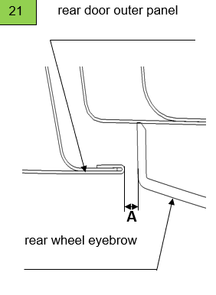
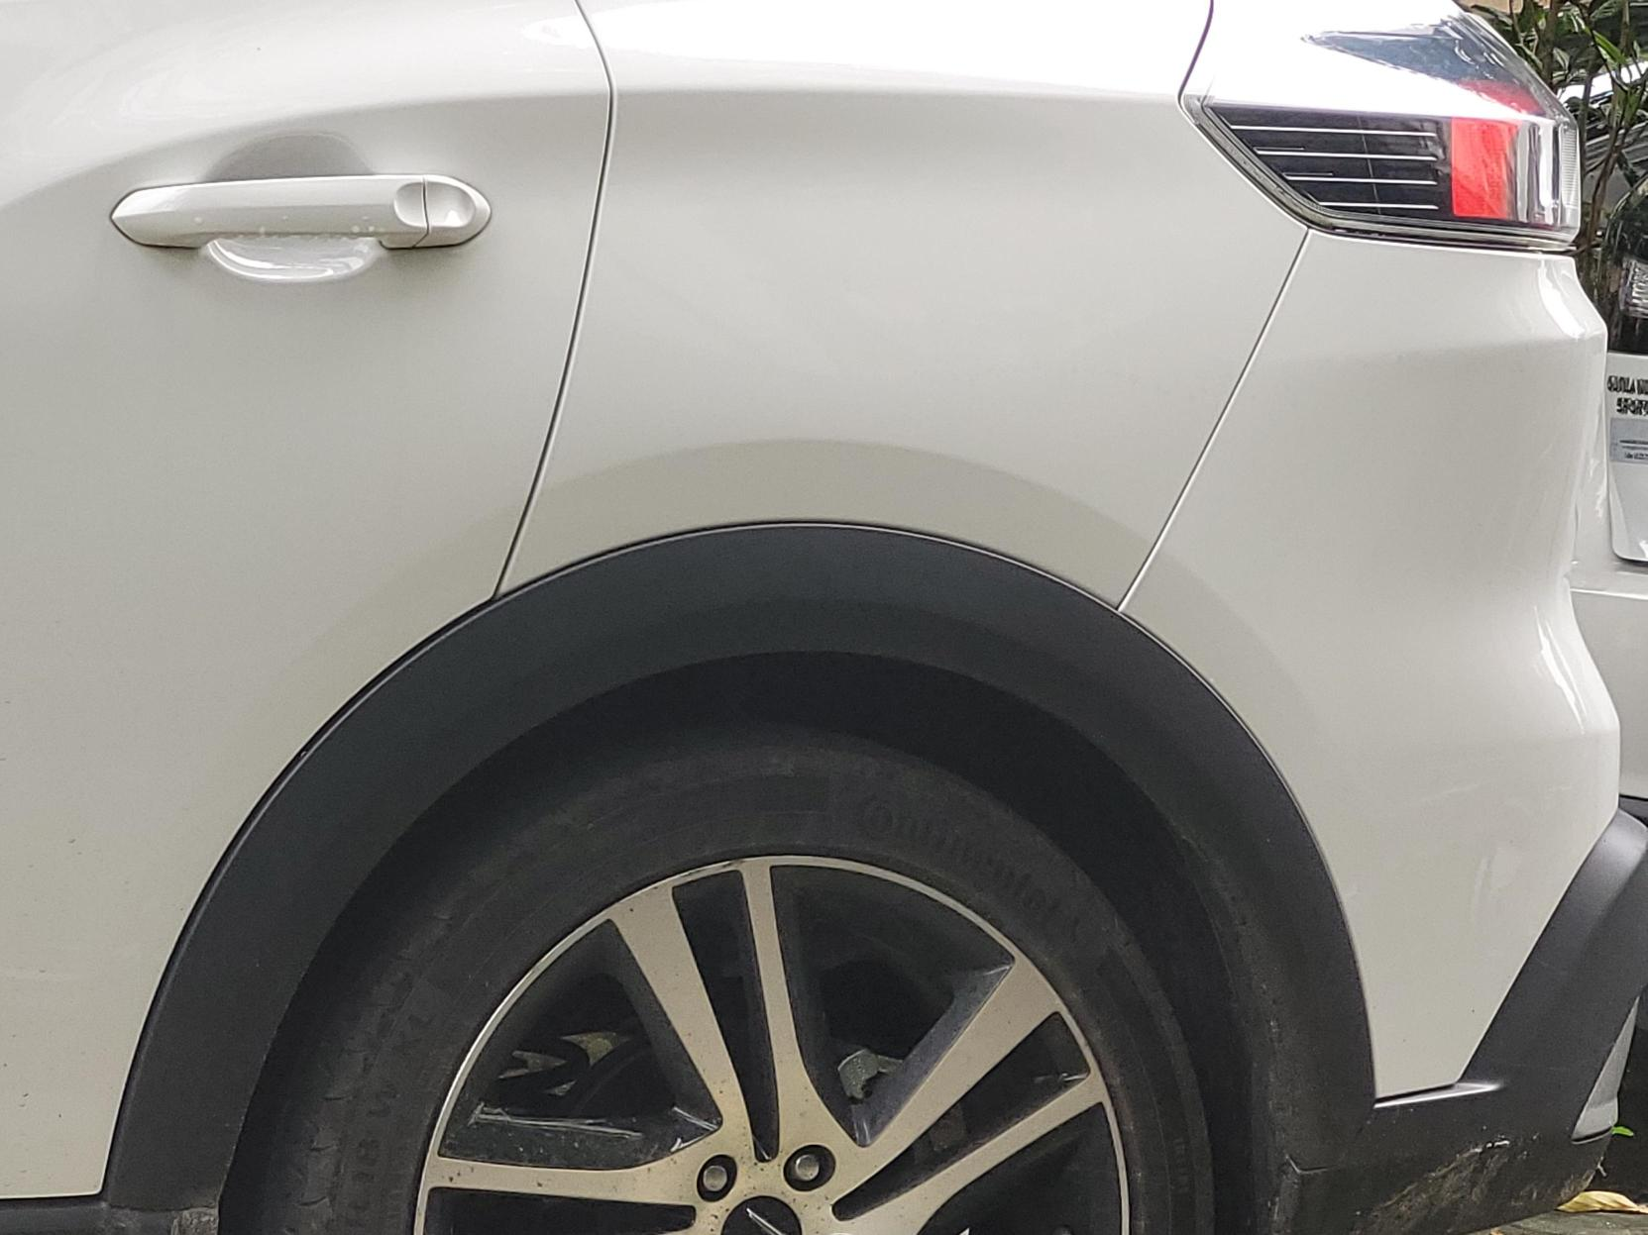
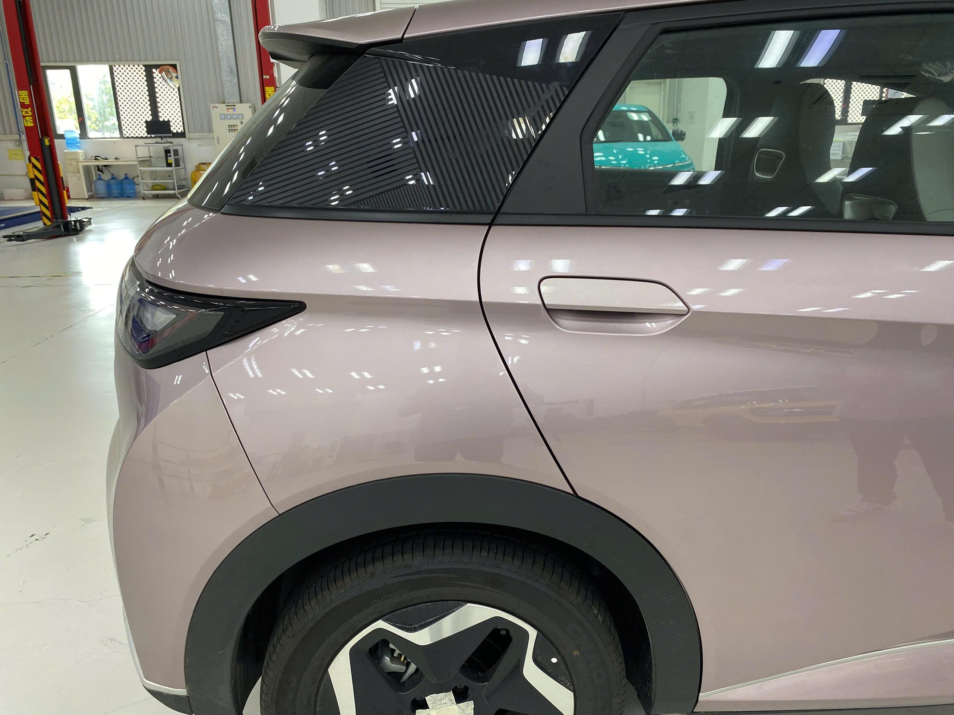
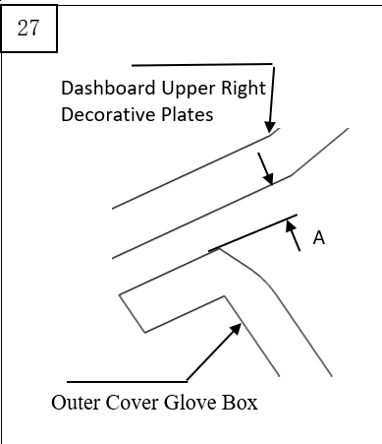
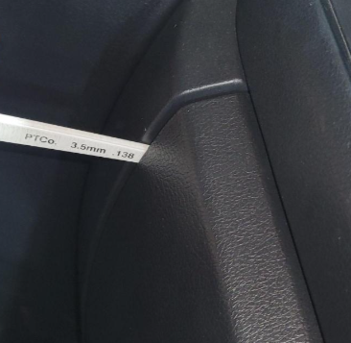
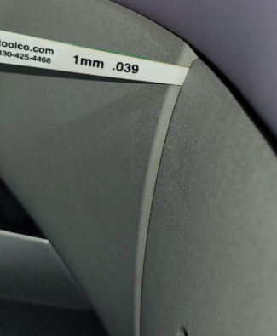
Gap & flush measuring and comparison with Bench marking
DTS No. | VFe34 DTS Section | VFe34 Actual | Benchmarking BYD Dolphin | PQ comment | Long term/Short term
6 |  |  |  | VFe34 is uncompetitive VFe34 is not better than BYD Dolphin in aesthetics point. VFe34 Gap value is out of spec | Long-term + Temporary countermeasure: Rework – Fix dog house location with heating gun → Result : the spec was satisfied + Permanent Countermeasure: Mock up test. In case of Mock up OK, mold modification after reflecting ECR
 | GAP: 7.0±1.5 FLUSH: N/A | GAP: Min 3.5 mm // Max 4.5 mm FLUSH: N/A | GAP: Min 3.5 mm // Max 4.5 mm FLUSH: N/A
27 |  |  |  | VFe34 is Competitive it’s not recognized by customer due to it's Zone Class D ( Any area of surface that is permanently covered by another part) | N/A
 | GAP: 2.5±1.0 FLUSH: N/A | GAP: 3.5 mm FLUSH: | GAP: 1.25 mm FLUSH:

Slide 20
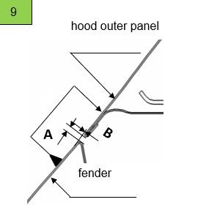
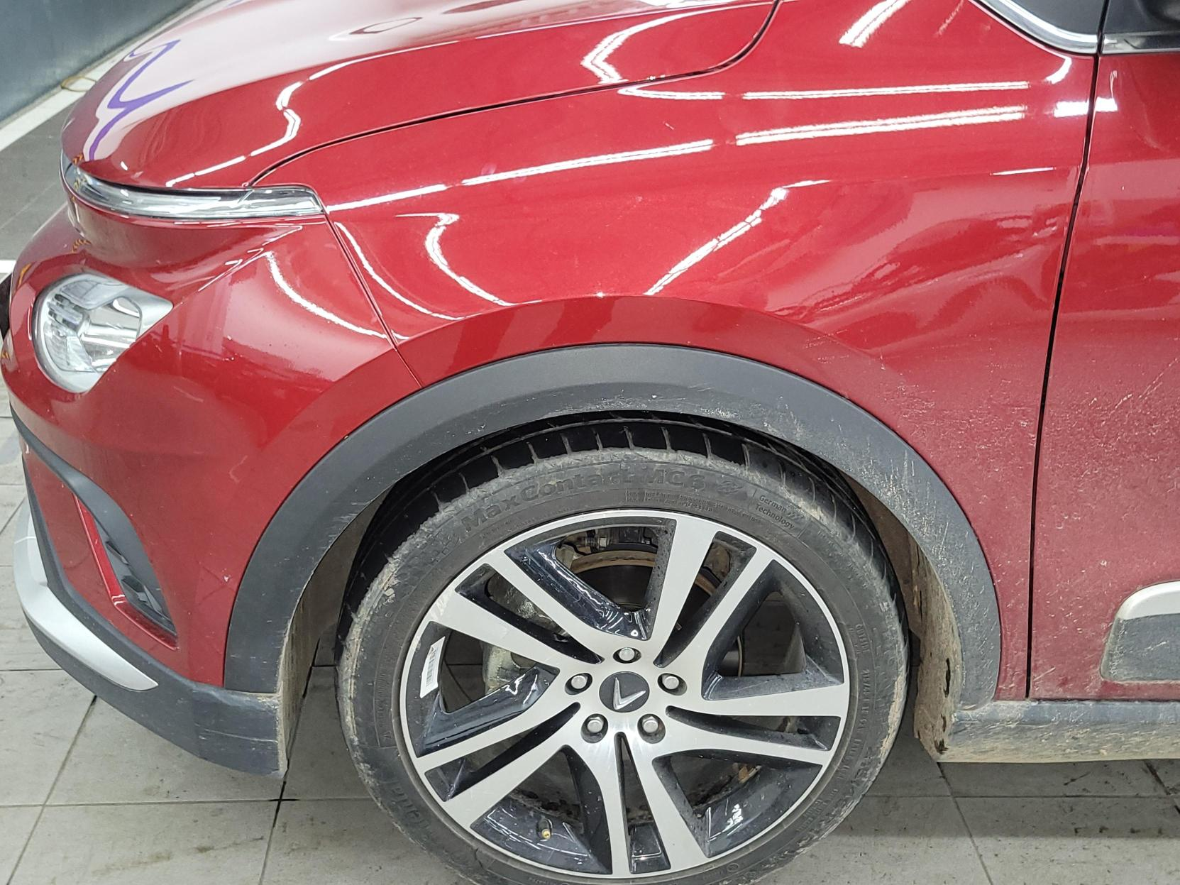
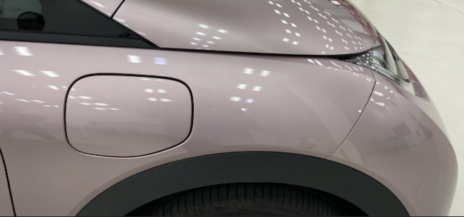
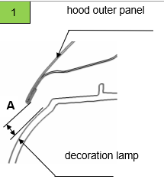
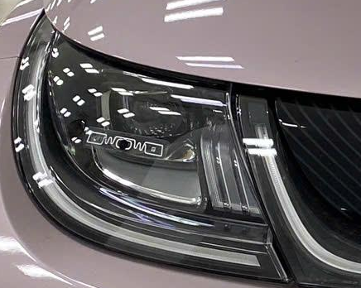
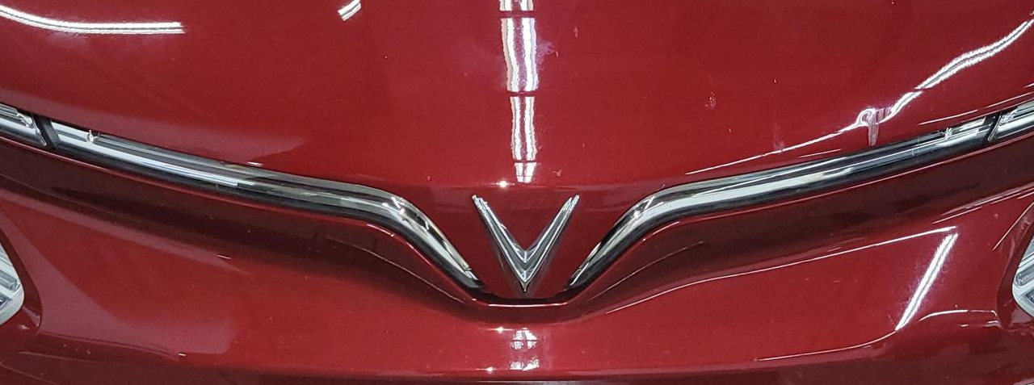
Gap & flush measuring and comparison with Bench marking
DTS No. | VFe34 DTS Section | VFe34 Actual | Benchmarking BYD Dolphin | PQ comment | Long term/Short term
6 |  |  |  | VFe34 Competitive but VFe34 interface concept is not favorable for customer perception. The flush should improve in the future (Too high 1.1 mm). | N/A
 | GAP: 3.5 ±1.2 FLUSH:0 ±1.2 | GAP: Min 3.4 mm // Max 4.7 mm FLUSH: Min -0.5 // Max 1.1 | GAP: Min 3.5 mm // Max 4.5 mm FLUSH: 0-2.0
1 |  |  |  | VFe34 competitive Although the gap is out of spec but it’s still good at aesthetic point as it is on the lower side of the Spec. | N/A
 | GAP: 7.0 ±1.5 FLUSH: N/A | GAP: Min 3.5 mm // Max 4.5 mm FLUSH: N/A | GAP: LH : 5.2 mm // RH : 5.8 mm FLUSH: N/A

Slide 21
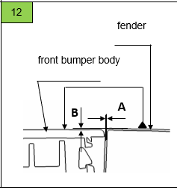
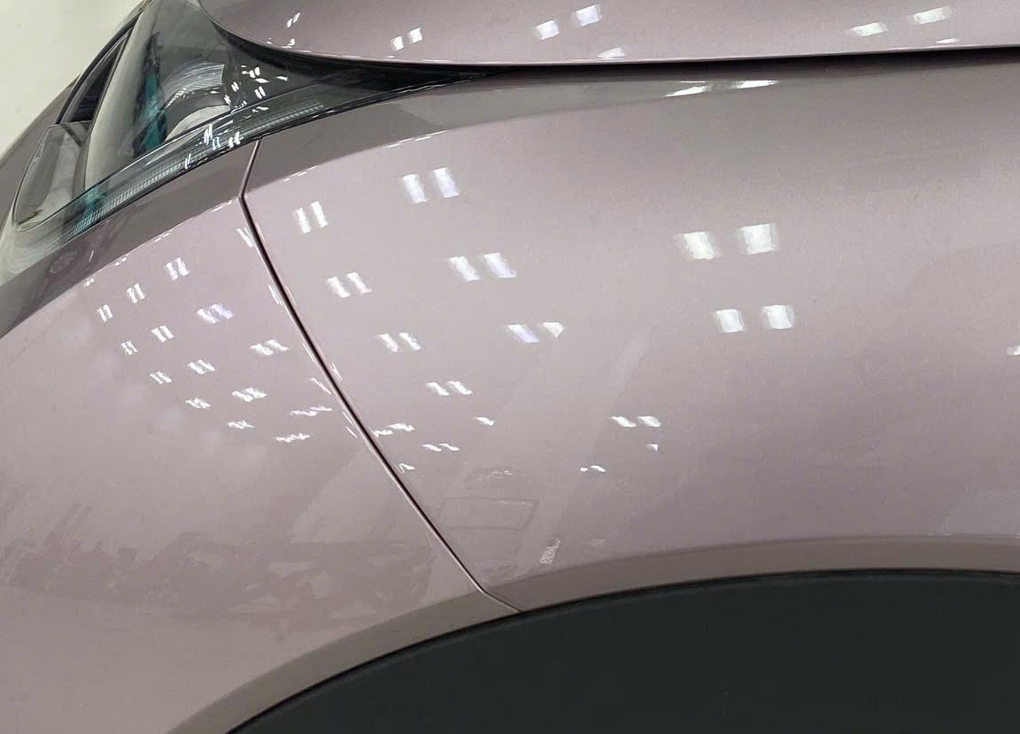
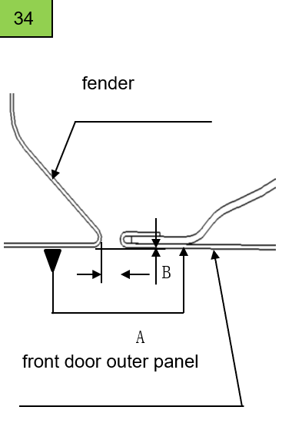
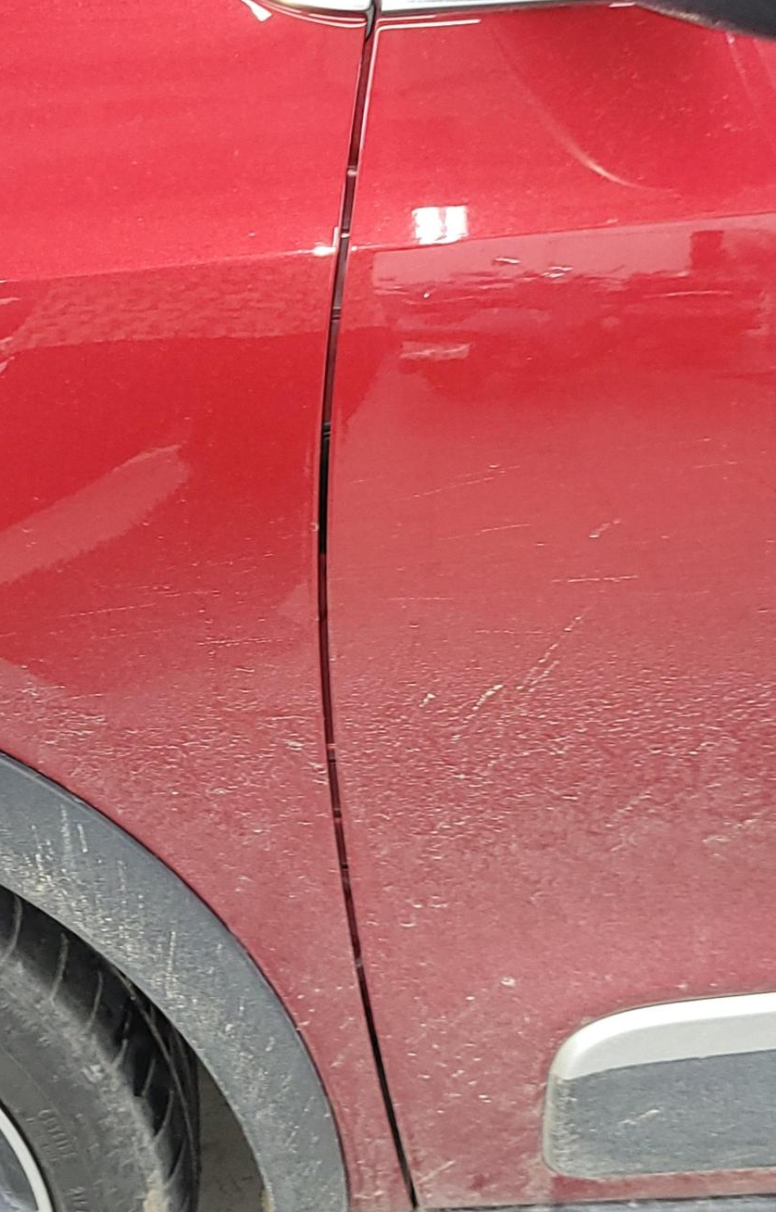
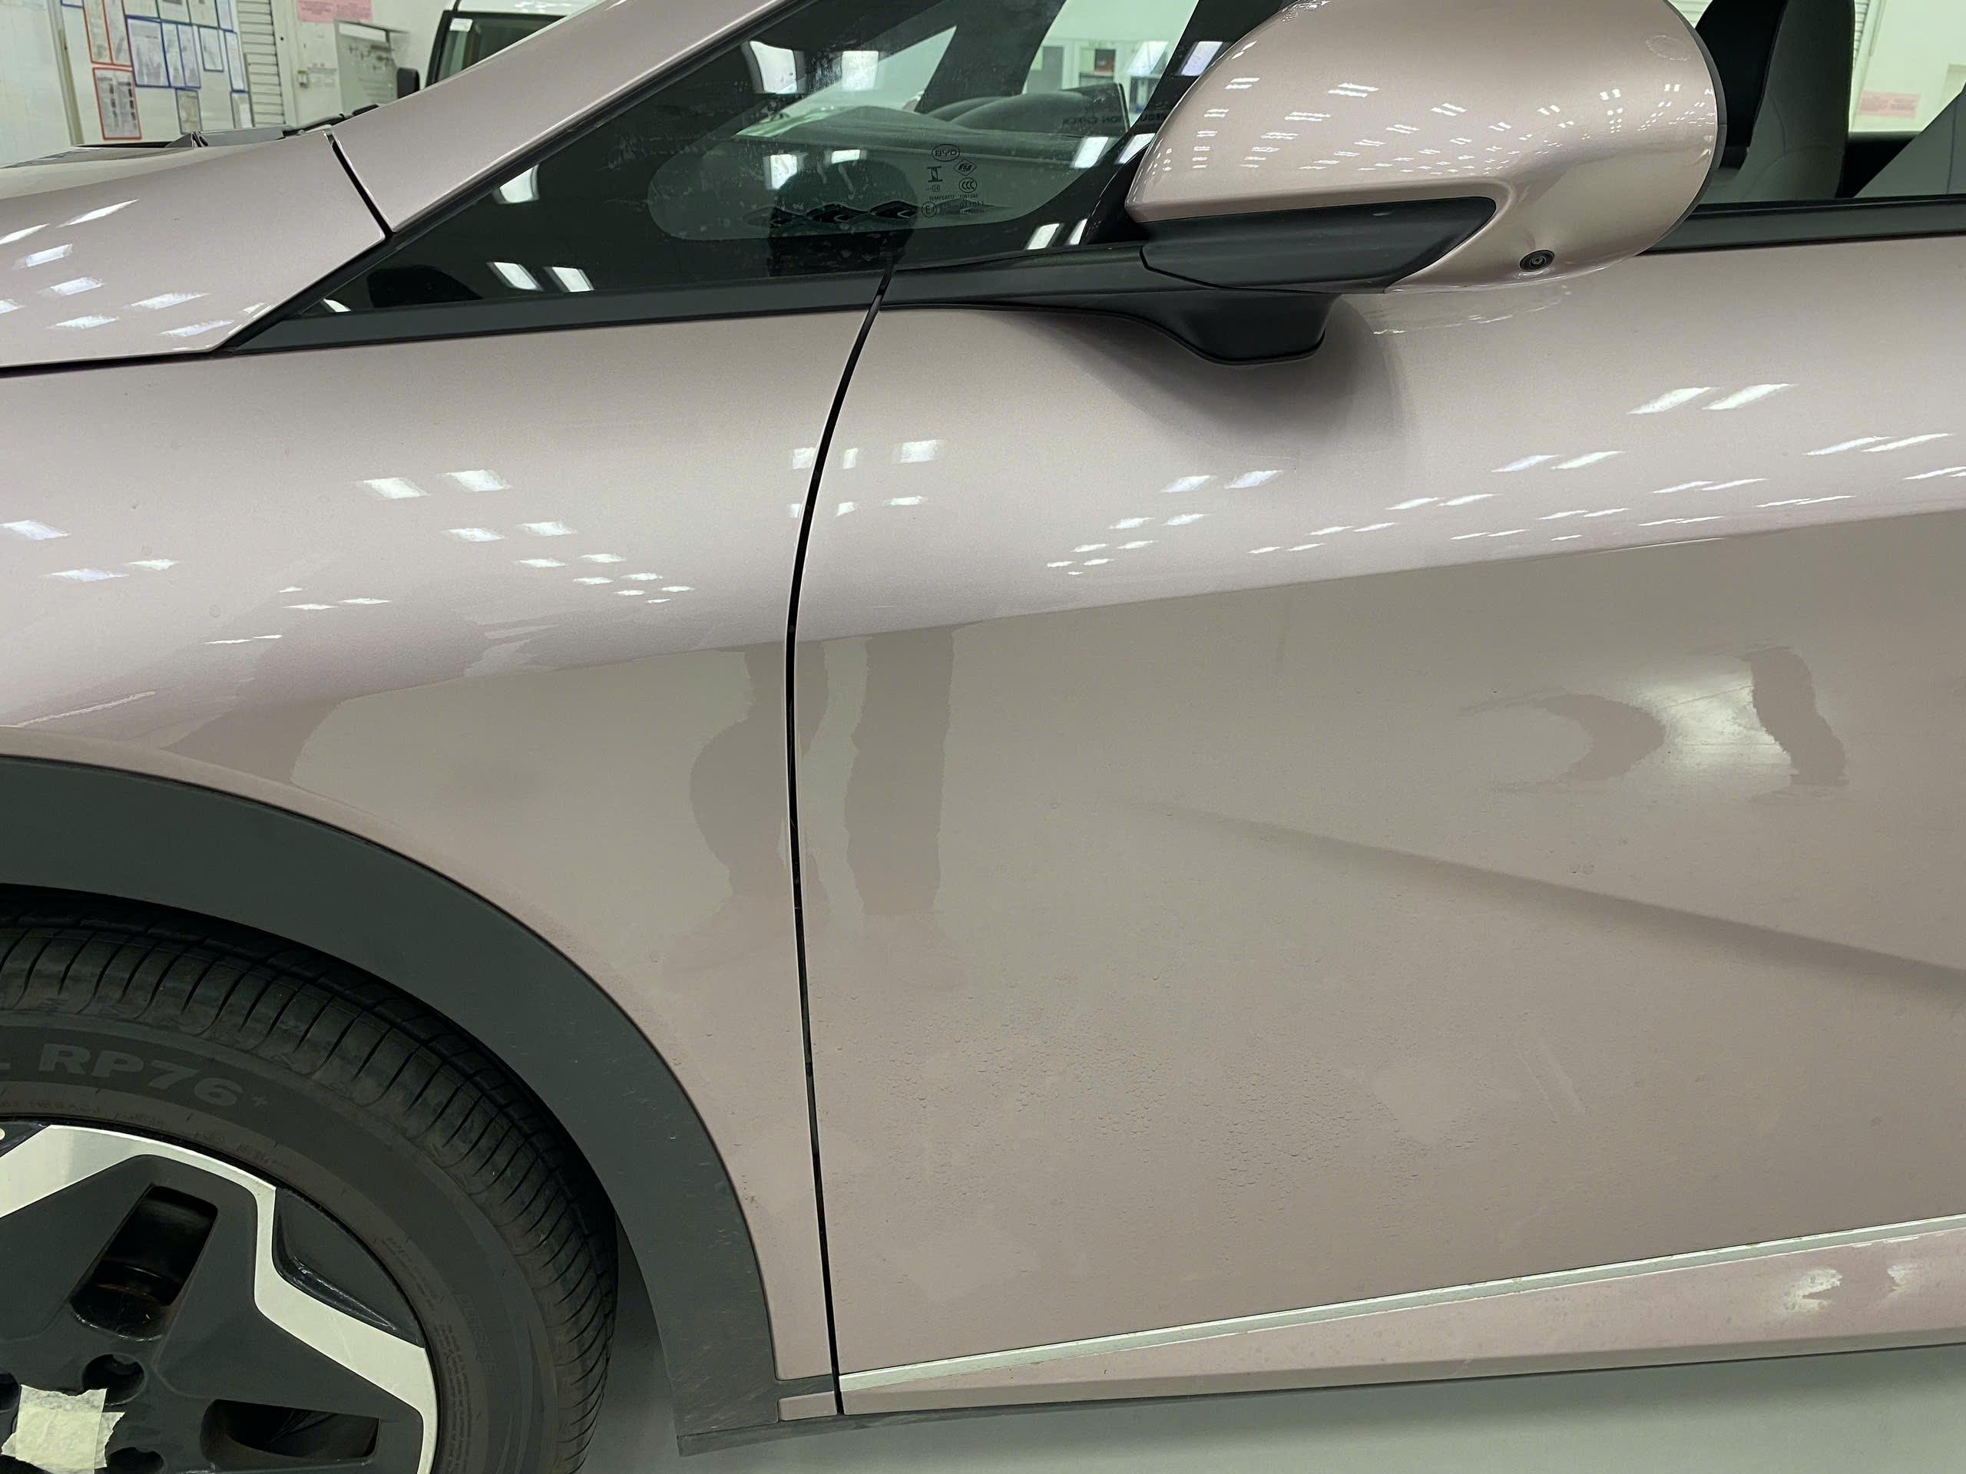
Gap & flush measuring and comparison with Bench marking
DTS No. | VFe34 DTS Section | VFe34 Actual | Benchmarking BYD Dolphin | PQ comment | Long term/Short term
12 |  |  |  | VFe34 Uncompetitive Customer do not identify variability due to V-Gap concept. | Long-term Need Exterior and Body team to monitoring and deep investigate root cause
 | GAP: 0.5±0.5 FLUSH:-0.5 ±0.5 | GAP: Min 0.75 mm // Max 1.5 mm FLUSH: 0 mm | GAP: 0.75 mm FLUSH: 0 mm
34 |  |  |  | VFe34 is Competitive DTS targets are competitive to Industry standards. | N/A
 | GAP: 4.0±1.0 FLUSH: 0±1.0 | GAP: 4.0 mm FLUSH: 0.5 mm | GAP: Min 3.5 mm // Max 4.0 FLUSH: 0.5 mm

Slide 22
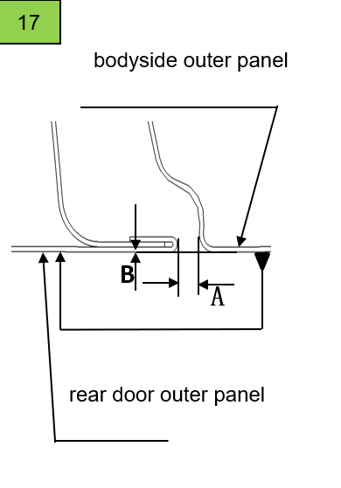
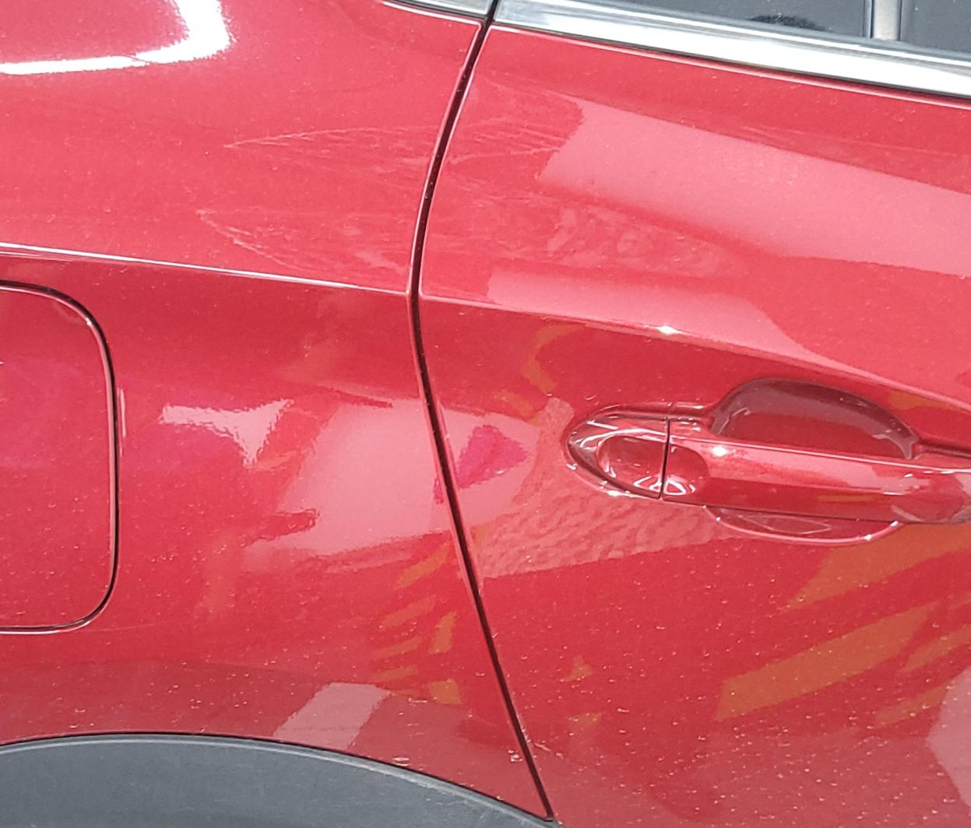
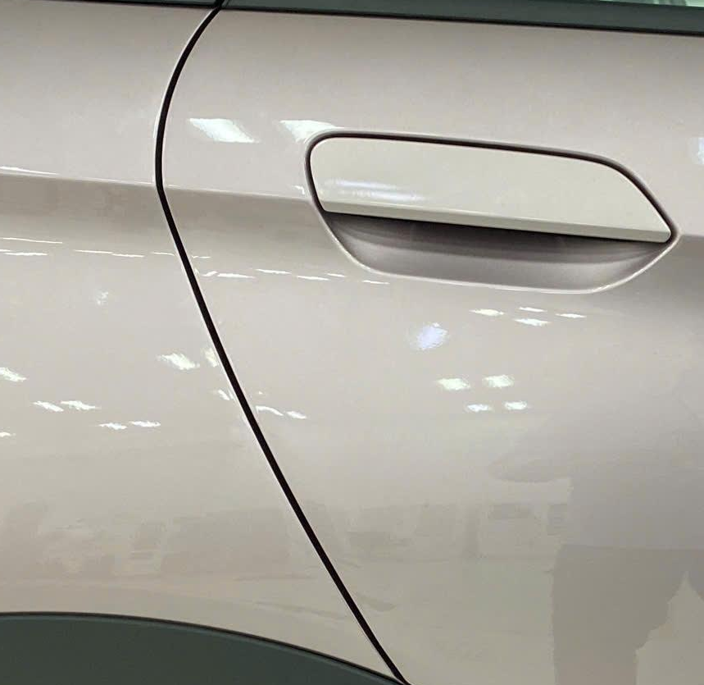



Gap & flush measuring and comparison with Bench marking
DTS No. | VFe34 DTS Section | VFe34 Actual | Benchmarking BYD Dolphin | PQ comment | Long term/Short term
17 |  |  |  | VFe34 is Competitive Gap in Spec. No over flush condition measured | N/A
 | GAP: 4.0±1.0 FLUSH:0±1.0 | GAP: 5.0 mm FLUSH: 0.25 mm | GAP: 4.5 mm FLUSH: 0 mm
6 |  |  |  | VFe34 is Competitive Gap in Spec. No over flush condition measured | N/A
 | GAP: 0.5±0.5 FLUSH: -0.5±0.5 | GAP: 0.5 mm FLUSH: -0.5 mm | GAP: Min 0.5 mm // Max 1mm FLUSH: 0.5 mm

Slide 23






Gap & flush measuring and comparison with Bench marking
DTS No. | VFe34 DTS Section | VFe34 Actual | Benchmarking BYD Dolphin | PQ comment | Long term/Short term
12 (Y-direction) |  |  |  | VFe34 is uncompetitive High variability, poor parallelism | Long-term Need QE Exterior team monitoring and investigate to define Root Cause
 | GAP: 4.5±1.2 FLUSH:0±0.7 | GAP: Min 3.5 mm // Max 5.0 mm FLUSH: | GAP: 4.5 mm FLUSH:
12-a (same item 12 but Z-direction) |  |  |  | VFe34 is Competitive DTS targets are competitive to Industry standards and VFe34 is better than BYD Dolphin about Gap parallel | N/A
 | GAP: 6±1.7 FLUSH: N/A | GAP: 6.0 mm FLUSH: N/A | GAP: Min 5.5 mm // Max 6.5 mm FLUSH: N/A

Slide 24






Gap & flush measuring and comparison with Bench marking
DTS No. | VFe34 DTS Section | VFe34 Actual | Benchmarking BYD seal | PQ comment | Long term/Short term
1 |  |  |  | VFe34 Uncompetitive Although Gap is in spec but it’s not good at aesthetics | Long-term Change design concept on freshening
 | GAP: 5.0 ~ 7.0 ±1.5 FLUSH | GAP: Min 6.5 mm // Max 7.5 mm FLUSH: | GAP: 2.0 mm FLUSH:
2 |  |  |  | VFe34 competitive Gap & Flush is in spec. | N/A
 | GAP: 6.0±2.0 FLUSH: 2.0±2.0 | GAP: Min 5 mm // Max 5.5 mm FLUSH: 1.5 mm | GAP: 8.5 mm FLUSH: 2.5 mm

